Slide 1
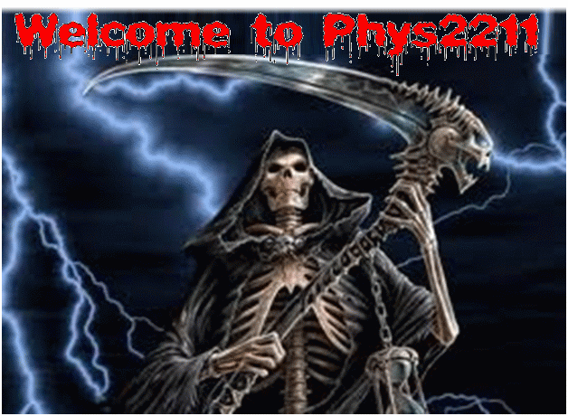
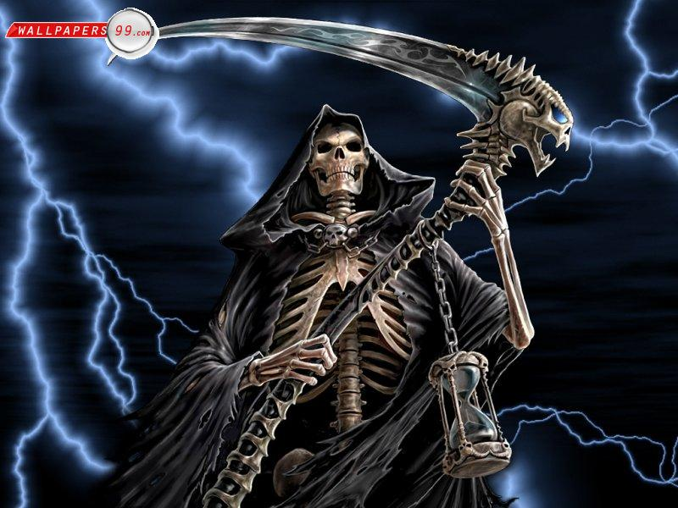

Slide 2
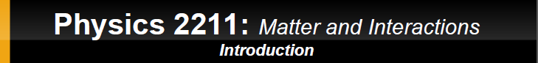
Why are you taking Physics?
They are making me!
(it is not optional)
Ok, so why is it necessary?

Slide 3
Physics, with the aid of math, describes basic principles that help us understand and describe our surroundings. From the micro to the macro-cosmos.
So, it is actually fun!
Anyone can enjoy and be successful at physics!
All you need is curiosity, skepticism and a little hard work

Slide 4
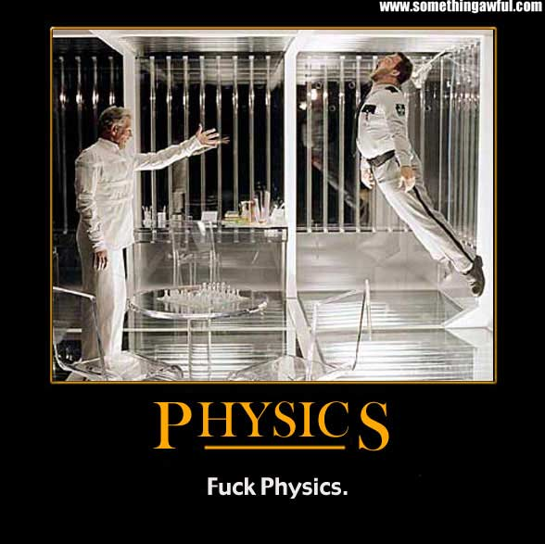
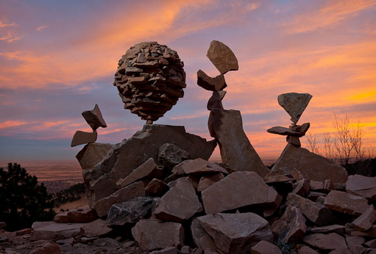
A bit less elegant definition
Why shit does stuff

Slide 5
I want you to learn!,
to have fun! and
to do well in the course!!
My Pledge to you:
I will try my best to teach you and to bring demonstrations so we can understand and assimilate better the material.
Be available to your questions (at office hours, by email or by appointment)
I expect from you:
To come to class, to pay attention and to do your homework.

Slide 6
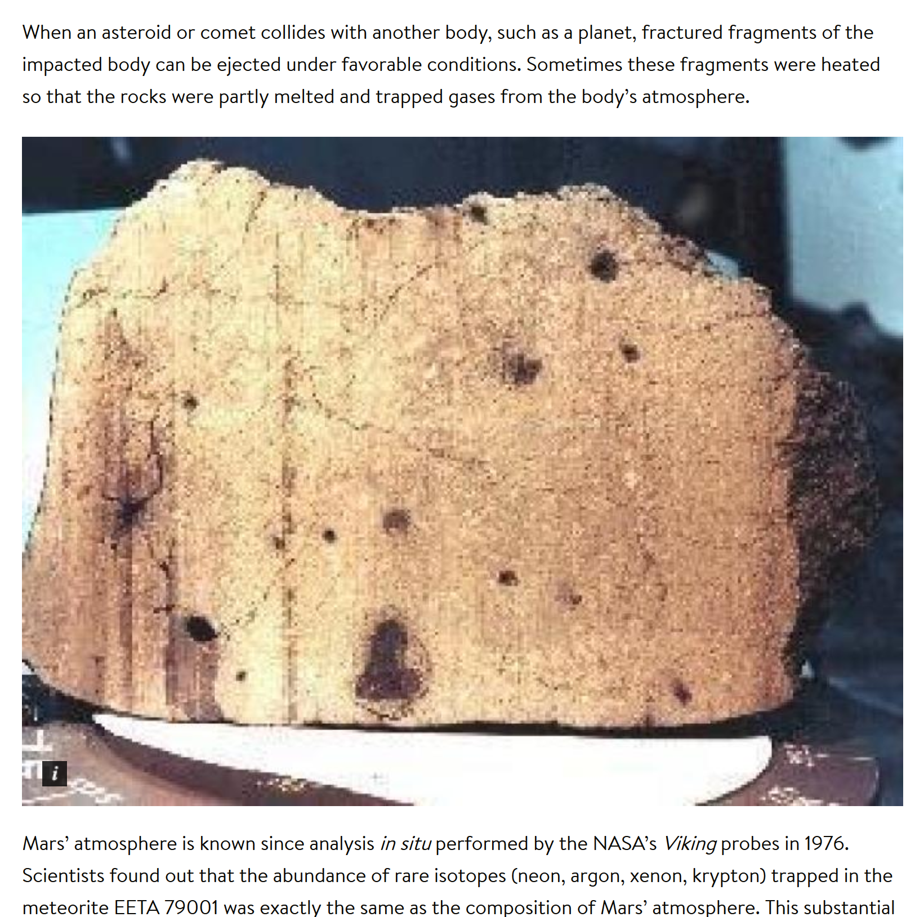
First example:
I brought a Moon rock and a Martian rock.
For everyone of you to touch at the end of the class.

Slide 7
Quick Example (fun):
Temperature of different objects

Slide 8
Quick Example (fun):
Temperature of different objects
Once you understood the physics behind
them, you now say “ah it make sense”
Physics: Common sense based on solid scientific knowledge.

Slide 9
Physics is the:
Liberal Arts Degree for Science
Doesn’t directly prepare students for any particular type of employment after college.
Provides students with many highly marketable skills.
physics opens up many opportunities in occupations related to finance, programming, healthcare, and engineering. In the end, every business runs on Math and Physics.

Slide 10
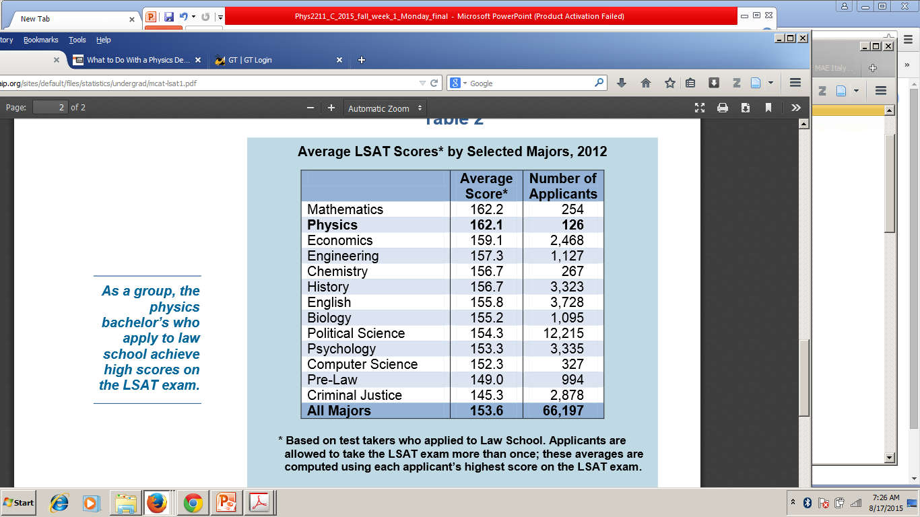
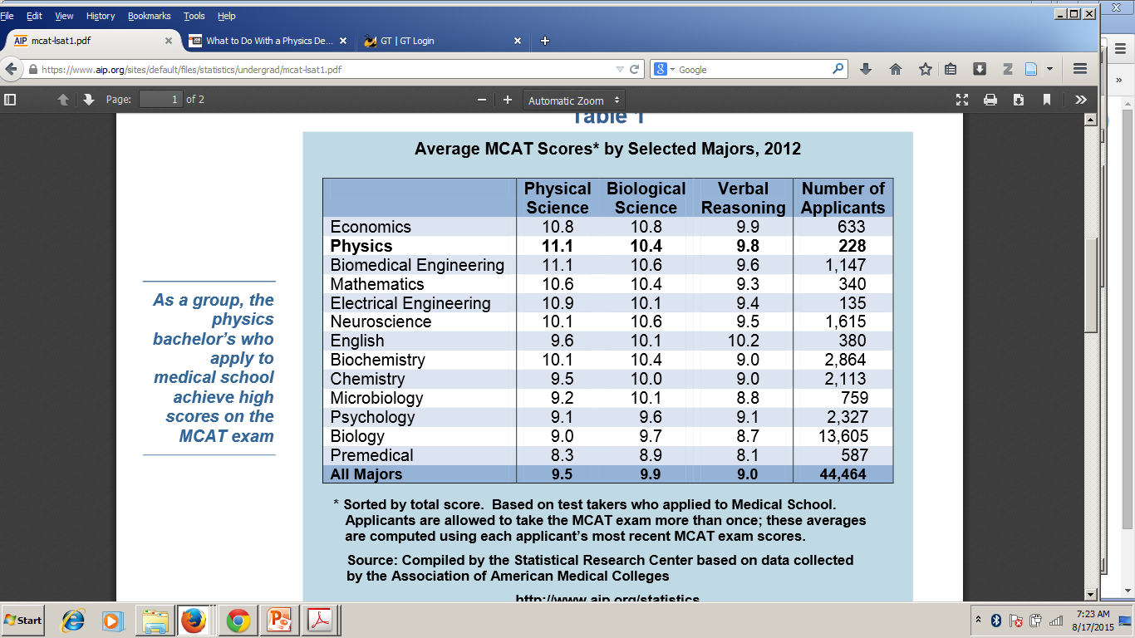
Physics is the:
Liberal Arts Degree for Science
Who gets the best MCAT and LSAT scores?

Slide 11
Physics is the:
Liberal Arts Degree for Science

Slide 12
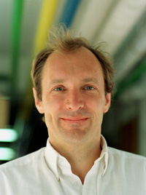
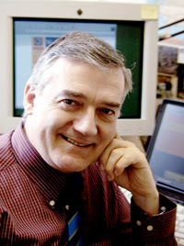
Innovations by physic(ists)
All areas of life:
WWW originated at CERN (physics lab)
Internet!
Tim Berners-Lee followed his dream of a better, easier way to communicate via computers on a global scale, which led him to create the World Wide Web.
Robert Cailliau, collaborator on the World Wide Web project and first Web surfer.

Slide 13
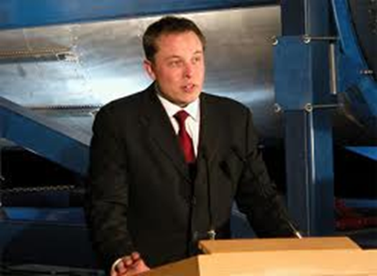
Innovations by physic(ists)
All areas of life:
+ Elon Musk
Pay Pal
Tesla Cars
SpaceX
Hyperloop (L.A. ←→ S.F. in 30min)

Slide 14
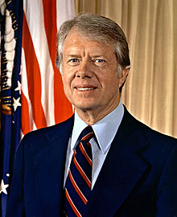
All areas of life:
Jimmy Carter 39th
president of the US
2002 Nobel peace prize
Jimmy Carter took Math classes at GT before moving to the Naval Academy and later attended graduate school majoring in reactor technology and nuclear physics
His eldest son John William Carter, earned a degree in physics at GT

Slide 15
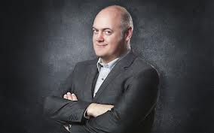

All areas of life:
Dara O’briain
Irish stand-up comedian
Degree in theoretical physics from Trinity College Dublin Carter
First homework:
http://www.youtube.com/watch?v=BVxOb8-d7Ic
Dara O'Briain explains modern technology

Slide 16

Angela Merkel,
German Chancellor
(Elected 4 times)
Most powerful woman in the world (Forbes list of the top 100 women from all areas including business, politics, entertainment and technology).
PhD in physics and conducted research in quantum chemistry

Slide 17
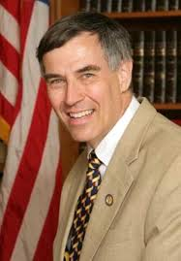

Rush D. Holt, Jr.,
N.J. Congressman
I.B.M.’s Watson may have pummeled Jeopardy! champions Ken Jennings and Brad Rutter. But New Jersey Congressman Holt beat Watson.
Finished his round with 8,600 points to Watson’s 6,200
PhD in physics, New York University.

Slide 18
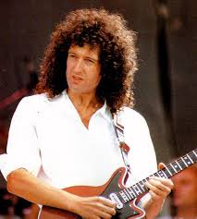

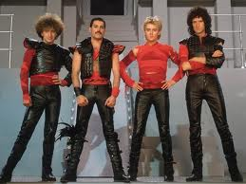
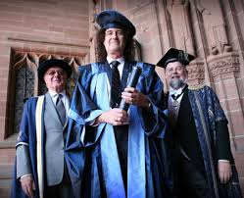
Brian May,
Queen’s guitar
Ph.D. In astrophysics from the Imperial College, London.
MgI Emission in the Night-Sky Spectrum (1972)
An Investigation of the Motion of Zodiacal Dust Particles (Part I) (1973)

Slide 19
So, Physics is useful (necessary), and fun!
Then, why students find physics courses hard?

Slide 20
Why students find physics courses hard?
While lectures are an effective method for imparting information.
They are however, less effective in encouraging independent thought.

Slide 21
Why students find physics courses hard?
While lectures are an effective method for imparting information.
They are however, less effective in encouraging independent thought.

Slide 22
Physics is not about memorizing formulas.
Is about thinking, analyzing, and using fundamental principles.

Slide 23
Physics is not about memorizing formulas.
Is about thinking, analyzing, and using fundamental principles.
But you need to reason.
(that takes practice)

Slide 24

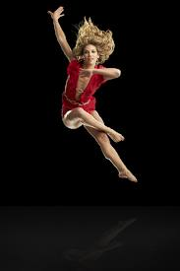
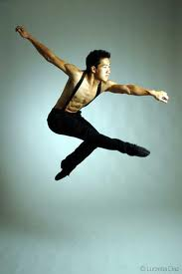
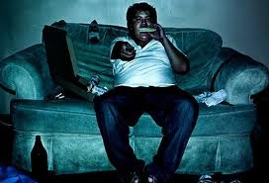
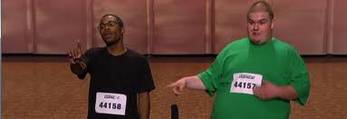
You need to dedicate time to work on problems
For example:
You may have seen all seasons of
You have some knowledge of dancing
but that does not mean you can dance!

Slide 25
You need to dedicate time to work on problems

Slide 26
You need to dedicate time to work on problems
You need to dedicate time to work on problems
You need to dedicate time to work on problems
You need to dedicate time to work on problems
Do the homework and seek understanding
not memorization.

Slide 27
SOME GUIDELINES FOR PROBLEM-SOLVING
Novice physics problem solvers tend to use pattern matching as a means of obtaining answers to physics questions
Pattern matching is sometimes an efficient way to get an answer, but it usually doesn't help you to become a better problem solver.
After making sure they understand the problem, physicists try to plan out their solution before proceeding.
We link the situation to one of the basic underlying ideas or principles of physics.
Only then will they select an appropriate set of equations based on how they have reinterpreted the problem, and perhaps select additional less general equations.

Slide 28
SOME GUIDELINES FOR PROBLEM-SOLVING
While there is no simple recipe for solving problems, four steps to take are:
(1) Understand: Read, sketch diagrams.
(2) Plan: what physical principles, laws, or equations are
relevant to the problem, find variables and parameters.
(3) Execute: Solve all equations, then substitute values AND
units.
(4) Review: Does your answer make sense? (Both physically and
numerically, evaluate limiting cases of your solution), do
you have the right units?, right magnitudes? (plausible).

Slide 29
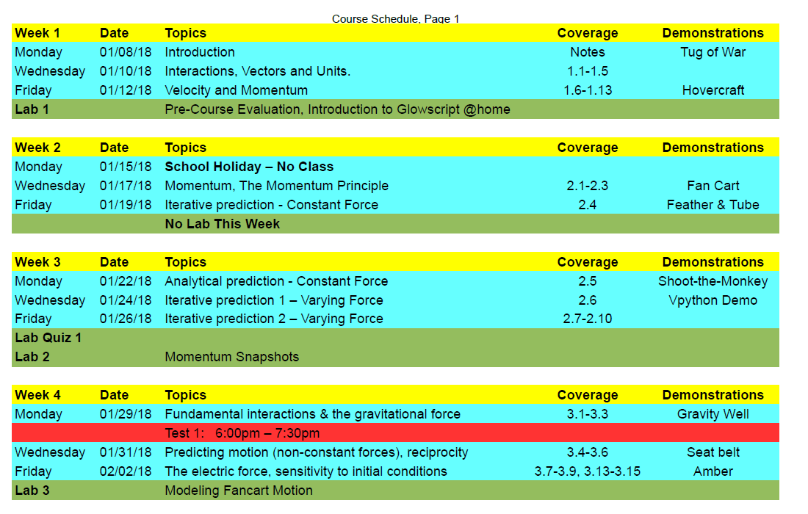
Class schedule and syllabus:
Found on Canvas

Slide 30
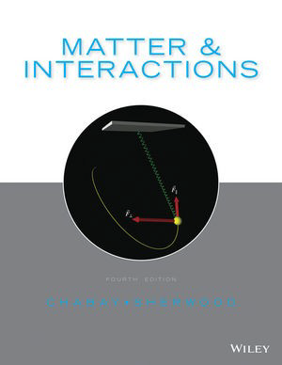
All Resources:
Class schedule,
homework, (WebAssing)
lab exercises,
extra practice problem sets,
and previous exams:
On Canvas
http://canvas.gatech.edu/
Book is free with WebAssing

Slide 31
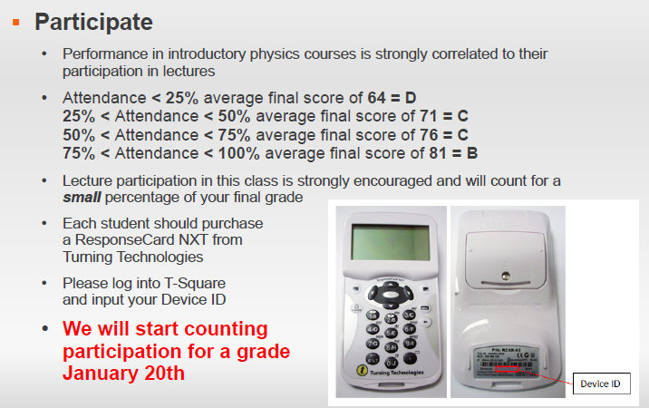
About Participation:
Monday , January 22th

Slide 32
Final grades will be calculated according to the following weight:
Four Evening Tests (6%,9%,12%,18%) 45%
Final Exam 25%
Lab 20%
Lab exercises 15%
Lab Quizzes 5% (25 min beginning of each lab)
The Bucket Points – Earn 10 points from any or all combination
Homework 5%
Participation 4%
Optional Assignments (extra phys. problems 3%
Wiki Resources 2%
Public lecture reviews 1%
Reading Assignments (due Wednesdays) 1%

Slide 33
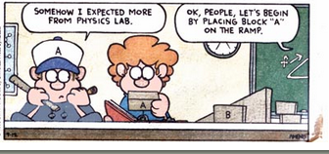
About the lab:
Clough Building
Once a week ~ 3h

Slide 34
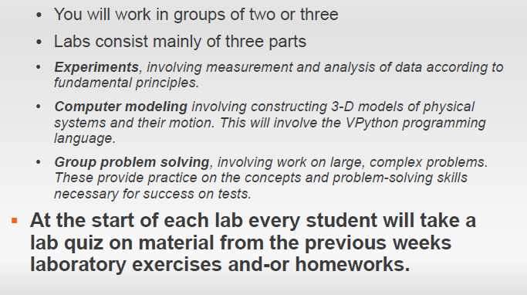
About the lab:
Clough Building
Once a week ~ 3h

Slide 35
About Homework:
Homework is due on Sundays at 11:59pm
The first week assignments (hw, intro & lab) are already posted to WebAssign. After the first week we will start posting assignments in blocks of 3-4 weeks; basically what will be covered up tot the next test.
Tip: Practice on the book exercises (w/answers) before taking the homework on line.

Slide 36
For homework and preparing for exams:
Please get help if you need it!
● Your grade is not a measure of how hard you work but how
well you understand physics principles
● When you are stuck, speak with a physics expert
– Don't wait until the last minute
– Office hours will be posted on Tsquare
● In person is always more efficient than by phone, email or
pony express.
● Clough Help Center 280 (physics hours posted online)
● Don't be intimidated or embarrassed
– You aren't expected to know everything
– We desperately want you to do well
Remember, extra problems and previous exams on line

Slide 37
About Honor and Conduct:
The Policy on academic honesty as stated in the Honors Code will be fully enforced for both the instructor and student: http://www.honor.gatech.edu/
Collaboration with other students in this course on HW and in-class activities is permitted.
No second WebAssign accounts.
Don’t use another student’s Clicker in class.
No collaboration permitted on lab quizzes, tests and final exam.
Honor code violations will be referred to the Dean of Students.

Slide 38
About Testing: Tests are always on a Monday.
01/29/18, 02/19/18, 03/26/18, 04/16/18, 04/30/18
Final:
Not same time
TBD
6pm to7:30 pm
Students expected to be on time for all test.
15 minutes late → discretion of the proctor.
A formula sheet for all quizzes, tests and exams will be included and is the same for all exams (see it posted in T-Square).
If you feel an error in grading, check with a TA no later than the start of the next test.

Slide 39
About Absences:
You are permitted to miss three lectures without documentation.
You can be excused for approved institute activities.
For other circumstances you’ll need documentation (court of law, doctor, funeral, religious leader, …)
No makeup labs.
Excused from an exam, your final exam will replace the missing test.

